Slide 1
Chapter 3: Digital transmission
5th Semester
Dept. of CSE

Slide 2
Introduction
The user data can be in one of two formats:
Analog: Human voice as converted by typical home telephones
Digital: Computer files
The transmitted signals, representing the data, can also be in one of two formats:
Analog or Digital
The conversion of the user data into a transmission signal is called Encoding.

Slide 3
Introduction
In data communications, the user data must be put in a format (signal) suitable for the transmission media
Four Possibilities:
Data | Signal | Technique
Digital | Digital | Encoding
Analog | Digital
Analog | Analog | Modulation
Digital | Analog

Slide 4
DIGITAL-TO-DIGITAL CONVERSION
Method to represent digital data by using digital signal
The conversion involves three techniques:
Line coding
Block coding and
Scrambling
Line coding is always needed
Block coding and scrambling may or may not be needed

Slide 5
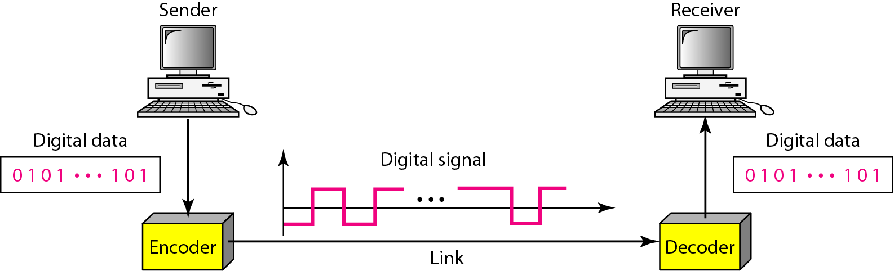
Line Coding
Converting a string of 1’s and 0’s (digital data) into a sequence of signals that denote the 1’s and 0’s.
For example a high voltage level (+V) could represent a “1” and a low voltage level (0 or -V) could represent a “0”.

Slide 6
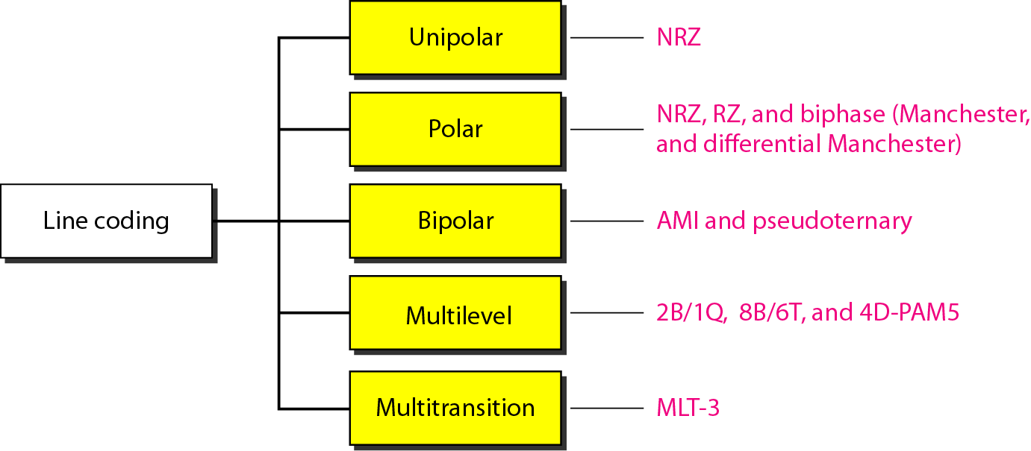
Line coding Schemes

Slide 7
Unipolar
All signal levels are on one side of the time axis
either above or below
NRZ - Non Return to Zero scheme is an example of this code.
Unipolar uses only one signal level (one polarity)
+ve voltage is binary “1”
No voltage (Zero) is binary “0”

Slide 8
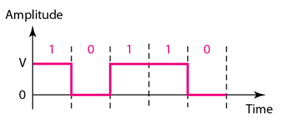
Example
Digital data to encode: 1 0 1 1 0

Slide 9
Why NRZ?
The signal Level does not return to Zero at the middle of bit.
Compared with its polar counterpart, this scheme is very costly.
The power needed to send 1 bit is double that for polar NRZ.
For this reason, this scheme is normally not used in data communications today.
.

Slide 10
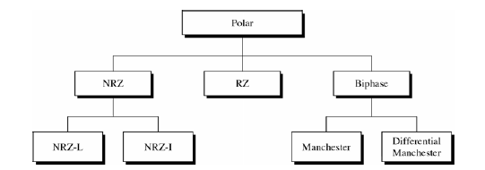
Types of Polar Encoding
Polar encoding uses two signal levels
Positive & Negative Polarities
Voltage are on the both side of time axis

Slide 11
Non-Return to Zero (NRZ)
NRZ encoding can be of two types:
NRZ-Level (NRZ-L)
“0” is encoded with one polarity, say “+5V”
“1” is encoded with another polarity, say “-5V”
NRZ-Invert (NRZ-I)
“0” is encoded with no change in polarity from previous bit
“1” is encoded with a change in polarity from previous bit

Slide 12
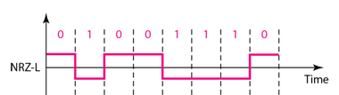
NRZ-Level (NRZ-L)
Digital Data: 0 1 0 0 1 1 1 0
+ve voltage for one symbol (say 0) and –ve voltage for the other symbol (say 1)

Slide 13
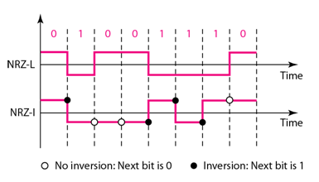
NRZ-Invert (NRZ-I)
1 symbol inverts the polarity and 0 does not.
i.e for each 1 in bit sequence, the signal is inverted but no change of level for bit 0
Digital Signal: 0 1 0 0 1 1 1 0

Slide 14
Characteristics of Line Encoding

Slide 15
Signal element vs. Data element
Data element:
Smallest entity that can represent a piece of information. (in bits)
Signal element:
Shortest unit (time-wise) of a digital signal.
Signal element carries data element
Signal Element Vs Data Element
Data Rate Vs Signal Rate

Slide 16
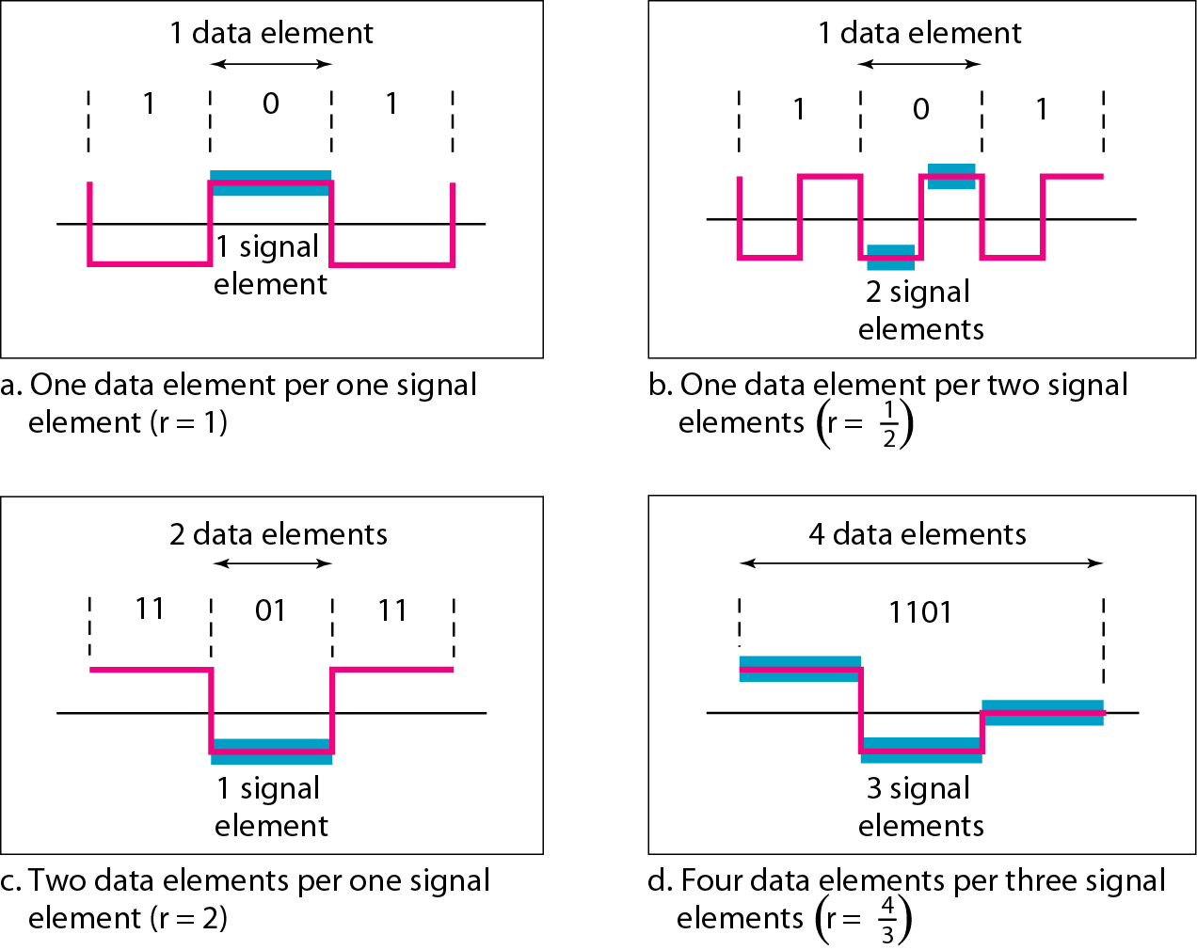
Signal element versus data element

Slide 17
Data rate vs. Signal rate
Data rate:
The number of data elements (bits) sent in 1s (bps).
It also called as bit rate.
Signal rate:
The number of signal elements sent in 1s (baud).
It is also called as pulse rate or baud rate.
We wish to:
Increase the data rate (increase the speed of transmission)
Decrease the signal rate (decrease the bandwidth requirement)

Slide 18
The baud or signal rate can be expressed as:
S_{avg} = c x N x 1/r bauds
where, N is data rate
c is the case factor (worst, best & avg.)
r is the ratio between data element & signal element
S is the baud rate or signal rate

Slide 19
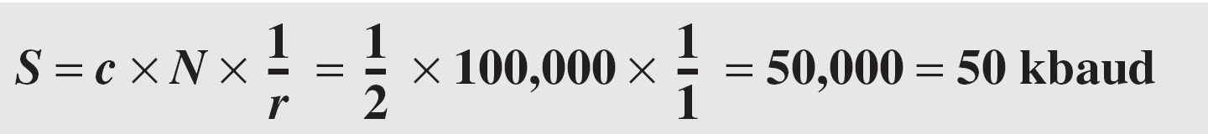
Example
A signal is carrying data in which one data element is encoded as one signal element. If the bit rate is 100 kbps, what is the average value of the baud rate if c is between 0 and 1?
Solution
We assume that the average value of c is 1/2 .
The baud rate is then

Slide 20
Baseline Wandering
A receiver will evaluate the average power of the received signal (called the baseline) and use that to determine the value of the incoming data elements.
If the incoming signal does not vary over a long period of time[long sequence of 0’s and 1’s], the baseline will drift and thus cause errors in detection of incoming data elements.
A good line encoding scheme should prevent long runs of fixed amplitude.
Needs to prevent baseline wandering

Slide 21
DC Component
When the voltage level remains constant for long periods of time [long sequence of 0’s or 1’s], there is an increase in the low frequencies of the signal.
Most channels may not support the low frequencies.
This will require the removal of the dc component of a transmitted signal.
A good line coding should not have any DC component.

Slide 22
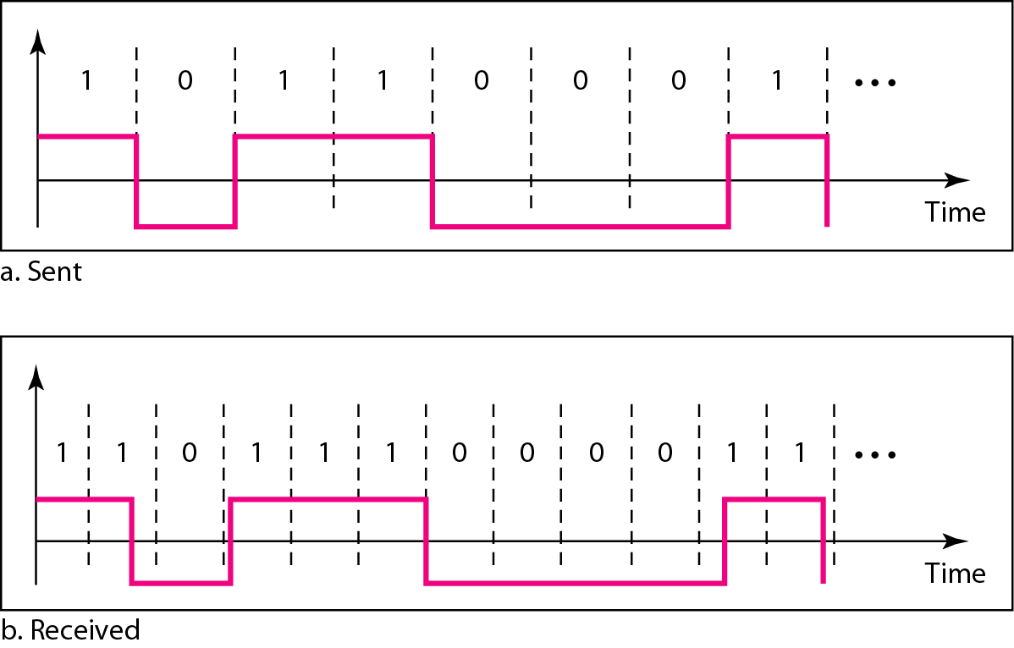
Self-Synchronization
The clocks at the sender and the receiver must have the same bit interval.
If the receiver clock is faster or slower it will misinterpret the incoming bit stream.
Effect of lack of synchronization

Slide 23
Issues
Both NRZ-I and NRZ-L suffers
Baseline wandering
Synchronisation problem
DC component problem

Slide 24
Polar - RZ
The Return to Zero (RZ) scheme uses three voltage values. +v, 0, -v.
Each symbol has a transition in the middle.
Either from high to zero or from low to zero.
This scheme has more signal transitions (two per symbol) and therefore requires a greater bandwidth.
No DC components or baseline wandering.
Self synchronization - transition indicates symbol value.
More complex as it uses three voltage level

Slide 25
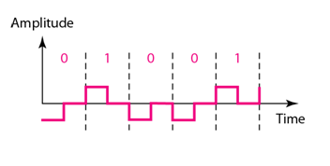
Polar - RZ
1 is encoded as: (+V, Transition 0V)
0 is encoded as: ( −V, Transition 0 V)

Slide 26
Polar - Biphase: Manchester
Manchester coding consists of combining the NRZ-L and RZ schemes.
Every symbol has a level transition in the middle:
from high to low or low to high.
It uses a polarity inversion in the middle of each bit
Low to high represents one
High to low represents zero
Uses only two voltage levels.

Slide 27
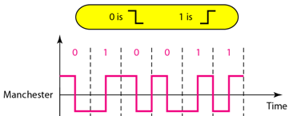
Manchester

Slide 28
Polar – Biphase : Differential Manchester
Differential Manchester coding consists of combining the NRZ-I and RZ schemes.
It used two voltage level
two signal changes to represent “0” and one signal change to represent “1”
Every symbol has a level transition in the middle.
If the next bit is 0, there is a transition in the beginning of bit (inversion)
If the next bit is 1, there is a no transition in the beginning of bit (no inversion)

Slide 29
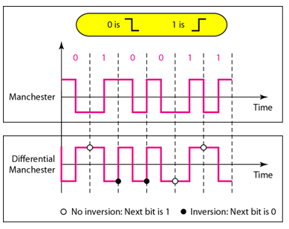
Differential Manchester

Slide 30
Manchester and Differential Manchester
In Manchester and differential Manchester encoding, the transition at the middle of the bit is used for synchronization.
The minimum bandwidth of Manchester and differential Manchester is 2 times that of NRZ.
There is no DC component and no baseline wandering.

Slide 31
Problem
Encode the following Digital date using Manchester and Differential Manchester
Digital Data: 0 0 1 1 0 1 0 1 1 1 0 0 1

Slide 32
Bipolar - Alternate Mark Inversion (AMI)
Code uses 3 voltage levels: - +, 0, -, to represent the symbols (note not transitions to zero as in RZ).
Voltage level for one symbol is at “0” and the other alternates between +ve and -ve.
The “0” symbol is represented by zero voltage and
The “1” symbol alternates between +V and -V.

Slide 33
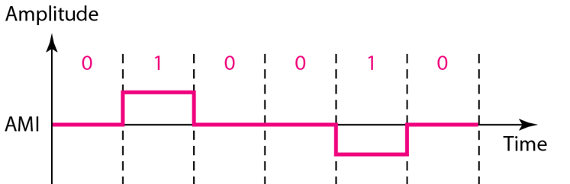
Bipolar - Alternate Mark Inversion (AMI)
Digital Data: 0 1 0 0 1 0
Assuming previous voltage level is -ve

Slide 34
Bipolar - Alternate Mark Inversion (AMI)
AMI alternates the voltage polarity for successive 1 bits
0 bits will be represented by “0V”
AMI lacks self-synchronization for long streams of 0

Slide 35
Bipolar - Pseudoternary
Pseudoternary is the reverse of AMI.
Code uses 3 voltage levels: - +, 0, -, to represent the symbols (note not transitions to zero as in RZ).
Voltage level for one symbol is at “0” and the other alternates between +ve and -ve.
The “1” symbol is represented by zero voltage and
The “0” symbol alternates between +V and -V.

Slide 36
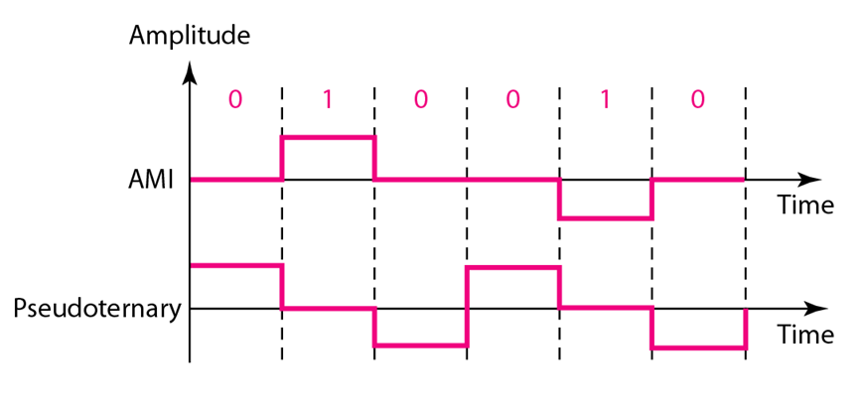
Bipolar - Pseudoternary
Digital Data: 0 1 0 0 1 0
Assuming previous voltage level is -ve

Slide 37
Bipolar schemes: AMI and pseudoternary
It is a better alternative to NRZ.
Has no DC component or baseline wandering.
Has no self synchronization because long runs of “0”s results in no signal transitions.

Slide 38
Multilevel Schemes
In these schemes we increase the number of data bits per symbol thereby increasing the bit rate.
Since we are dealing with binary data we only have 2 types of data element a 1 or a 0.
We can combine the 2 data elements into a pattern of m elements to create 2^{m} symbols.
If we have L signal levels, we can use n signal elements to create L^{n} signal elements.
Now we have 2^{m} symbols and L^{n} signals.

Slide 40
Multilevel Schemes
Depending on the length of binary pattern, length of signal patter and number of levels in signaling, code designer have classified coding as mBnL.
In the notation mBnL,
m is the length of the binary pattern,
B represents binary data,
n represents the length of the signal pattern and
L the number of levels.
L = B binary,
L = T for 3 ternary,
L = Q for 4 quaternary.
In mBnL schemes, a pattern of m data elements is encoded as a pattern of n signal elements in which 2^{m} ≤ L^{n}.

Slide 41
Multilevel: 2B1Q scheme
Two binary, one quaternary.
It uses data patterns of size 2 and encodes the 2-bit patterns as one signal element belonging to a four-level signal.

Slide 42
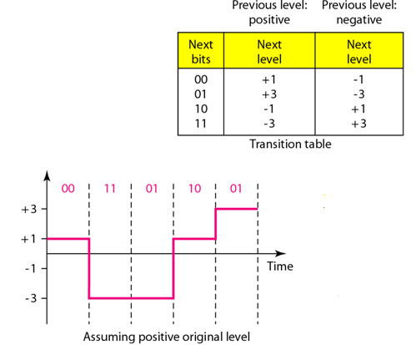
Multilevel: 2B1Q scheme

Slide 43
Multilevel: 8B6T scheme
Scheme is eight binary, six ternary
The idea is to encode a pattern of 8 bits as a pattern of 6 signal elements, where the signal has three levels (ternary) (-, 0 and +)
In this type of scheme, we can have 2⁸ = 256 different data patterns and 3⁶ = 729 different signal patterns
Suppose we have 0 0 0 1 0 0 0 1 can be encoded as - 0 – 0 + +
The idea is to encode a pattern of 8 bits with 6 signal element, where the signal has three levels.

Slide 44
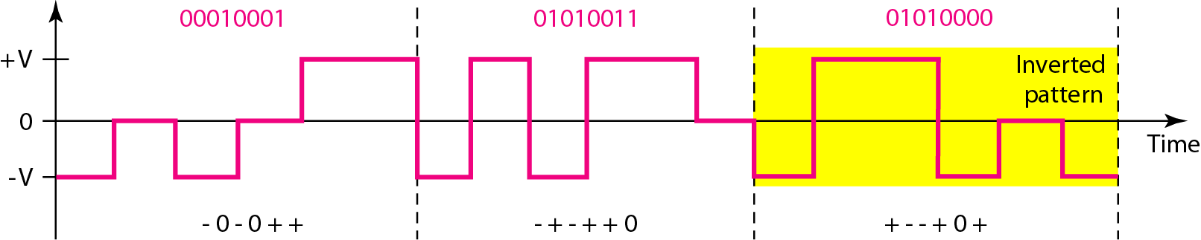
Multilevel: 8B6T scheme
Data to Encode: 0 0 0 1 0 0 0 1 0 1 0 1 0 0 1 1 0 1 0 1 0 0 0 0
Bit Pattern | Signal Pattern
0 0 0 1 0 0 0 1 | - 0 – 0 + +
0 1 0 1 0 0 1 1 | - + - + + 0
0 1 0 1 0 0 0 0 | + - - + 0 +

Slide 45
4D-PAM5
In some cases, we split the signal transmission up and distribute it over several links.
The separate segments are transmitted simultaneously.
This reduces the signaling rate per link -> lower bandwidth.
Four dimensional five-level pulse amplitude modulation.
The 4D means that data is sent over four wires (channel) at the same time.
It uses five voltage levels, such as -2, -1, 0, 1, and 2.
However, one level, level 0, is used only for error detection .
The technique is designed to send data over four channels (four wires).

Slide 46
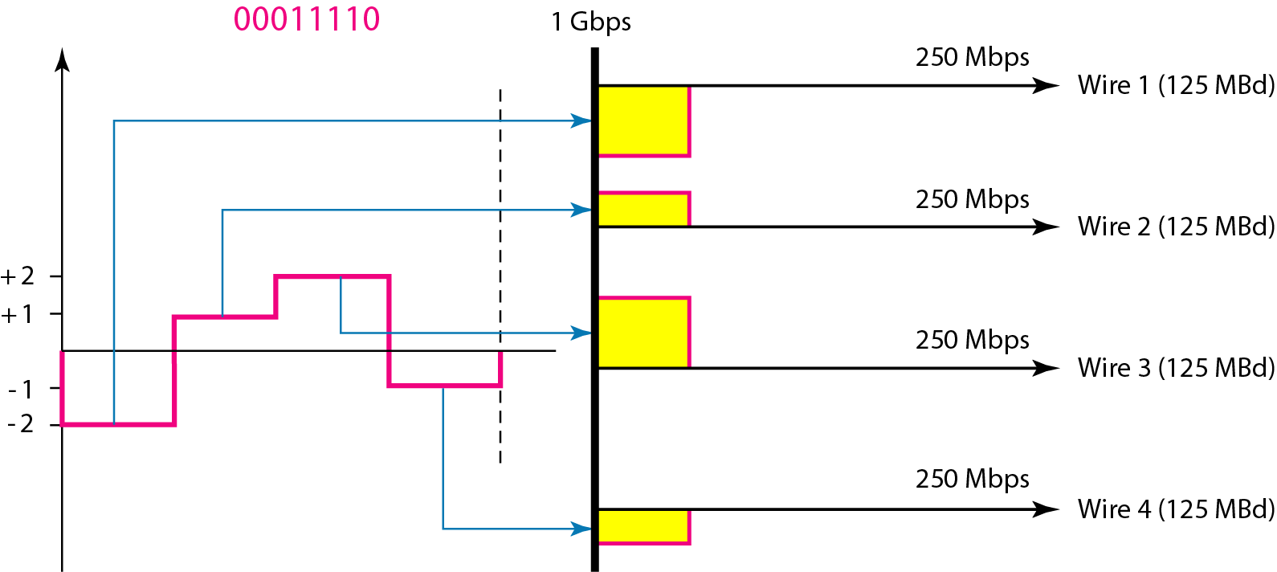
4D-PAM5 (8B4Q)
Scheme is eight binary, Four Quaternary
In this type of scheme, we can have 2⁸ = 256 different data patterns and 4⁴ = 256 different signal patterns

Slide 47
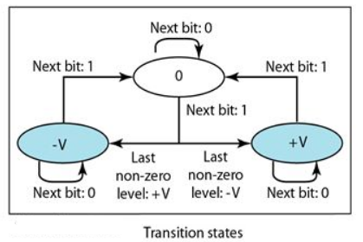
Multitransition: MLT-3 scheme
Multiline Transmission, three levels
It uses three voltage level (+, 0, -)
Three rules are:
If the next bit is 0, there is no transition.
If the next bit is 1 and the current level is not 0, the next level is 0.
If the next bit is 1 and the current level is 0, the next level is the opposite of the last nonzero level.

Slide 48
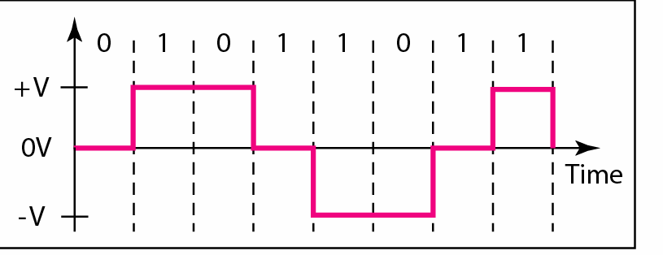
Multitransition: MLT-3 scheme
Data to Encode: 0 1 0 1 1 0 1 1 0
If the next bit is 0, there is no transition.
If the next bit is 1 and the current level is not 0, the next level is 0.
If the next bit is 1 and the current level is 0, the next level is the opposite of the last nonzero level.

Slide 49
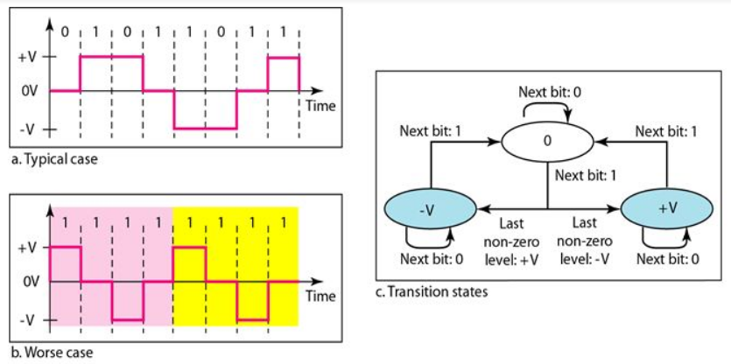
Multitransition: MLT-3 scheme

Slide 50
Exercise
Encode the following Digital date using MLT -3 Encoding Scheme.
A) 1 1 0 0 1 0 1 1 0
B) 0 1 0 1 1 0 1 1 1 0 1 1 0

Slide 51
Scrambling
Bipolar AMI encoding does not have a DC component.
However, a long sequence of Os upsets the synchronization.
If we can find a way to avoid a long sequence of Os in the original stream, we can use bipolar AMI for long distances.
To provide synchronization a solution is to substitutes long zero-level pulses with a combination of other levels to provide synchronization is called scrambling.

Slide 52
Scrambling
Sequences that would result in constant voltage are replaced by filling sequence that will provide sufficient transition for the receiver’s clock to maintain synchronization.
Filling sequence will be recognized by receiver and replace with original data sequence
Scrambling is done at the same time as encoding.
The system needs to insert the required pulses based on the defined scrambling rules.
Two common scrambling techniques are:
B8ZS and
HDB3

Slide 53
B8ZS Scrambling Techniques
Bipolar with 8-zero substitution
In this technique, eight consecutive zero-level voltages are replaced by the sequence OOOVBOVB.
V stands for violation, it violates the line encoding rule and
B stands for bipolar, it implements the bipolar line encoding rule
This table provides the sequence of 8 different voltage level that can be used to replace the sequence of 8 consecutive 0’s based on what the preceding voltage level was
Last Pulse | Substitution
+ | 0 0 0 + - 0 - +
- | 0 0 0 - + 0 + -

Slide 54
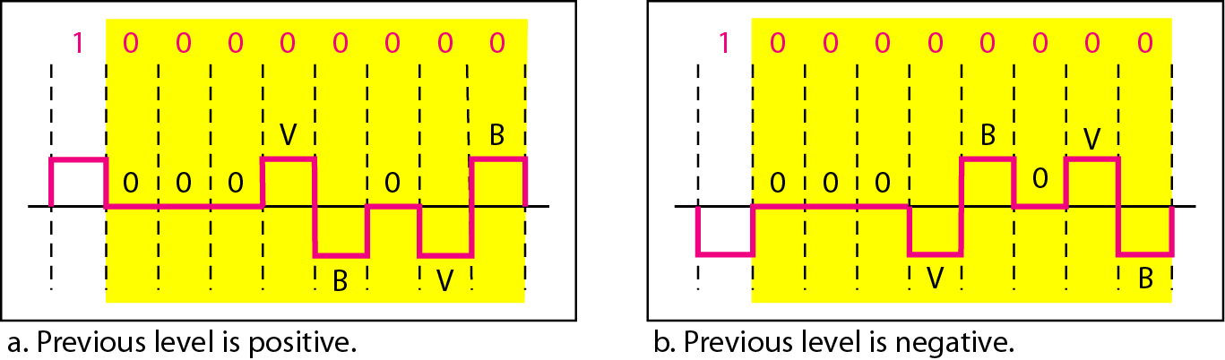
Two cases of B8ZS scrambling technique
Last Pulse | Substitution
+ | 0 0 0 + - 0 - +
- | 0 0 0 - + 0 + -

Slide 55
HDB3 Scrambling Techniques
High-Density Bipolar-3 Zero
Based on bipolar-AMI
HDB3 substitutes four consecutive zeros with 000V or B00V depending on the number of nonzero pulses after the last substitution.
The two rules can be stated as follows:
If the number of nonzero pulses after the last substitution is odd, the substitution pattern will be OOOV
If the number of nonzero pulses after the last substitution is even, the substitution pattern will be BOOV

Slide 56
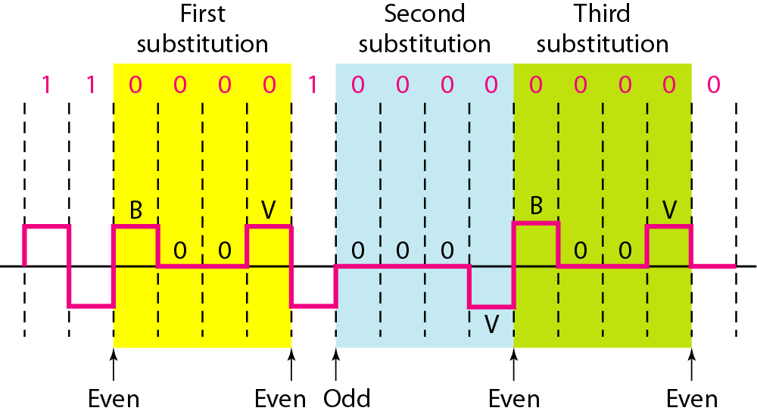
HDB3 Scrambling Techniques
Last Pulse | Number of 1’s since last substitution
 | Odd | Even
- | 0 0 0 - | + 0 0 +
+ | 0 0 0 + | - 0 0 -

Slide 57
Block Coding
It is used to improve the performance of Line Coding
Introduce redundancy to achieve synchronization.
Allows error detection to some extend.
Block coding is normally referred to as mB/nB coding
It replaces each m-bit group with an n-bit group.
In general, block coding changes a block of m bits into a block of n bits, where n is larger than m.

Slide 58
Block Coding
Block coding normally involves three steps:
Division : In the division step, a sequence of bits is divided into groups of m bits. For example, in 4B/5B encoding, the original bit sequence is divided into 4-bit groups.
Substitution: In substitution step, we substitute an m-bit group for an n-bit group. For example, in 4B/5B encoding we substitute a 4-bit code for a 5-bit group.
Combination: The n-bit groups are combined together to form a stream. The new stream has more bits than the original bits.

Slide 59
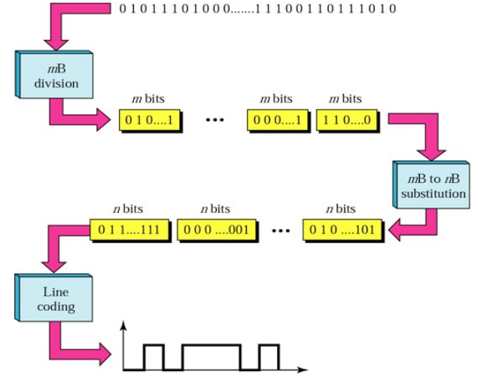

Slide 60
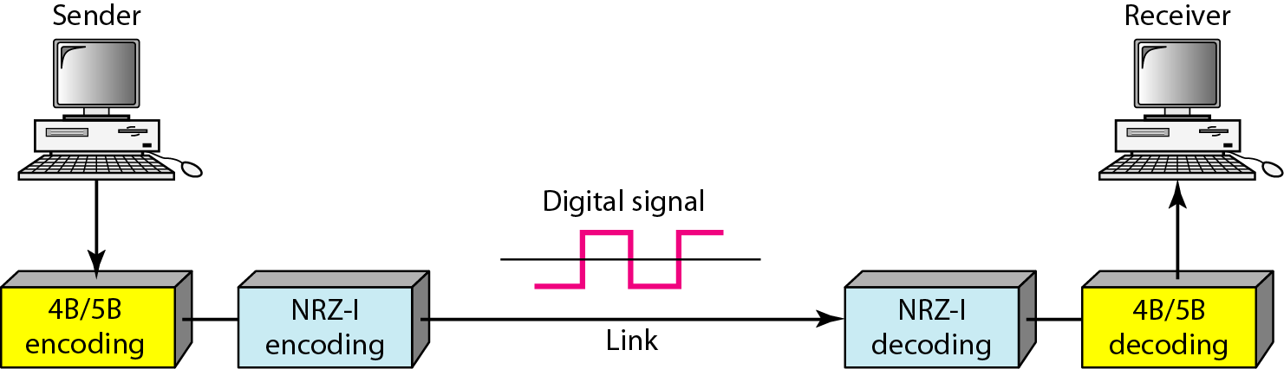
Using block coding 4B/5B with NRZ-I line coding scheme

Slide 61
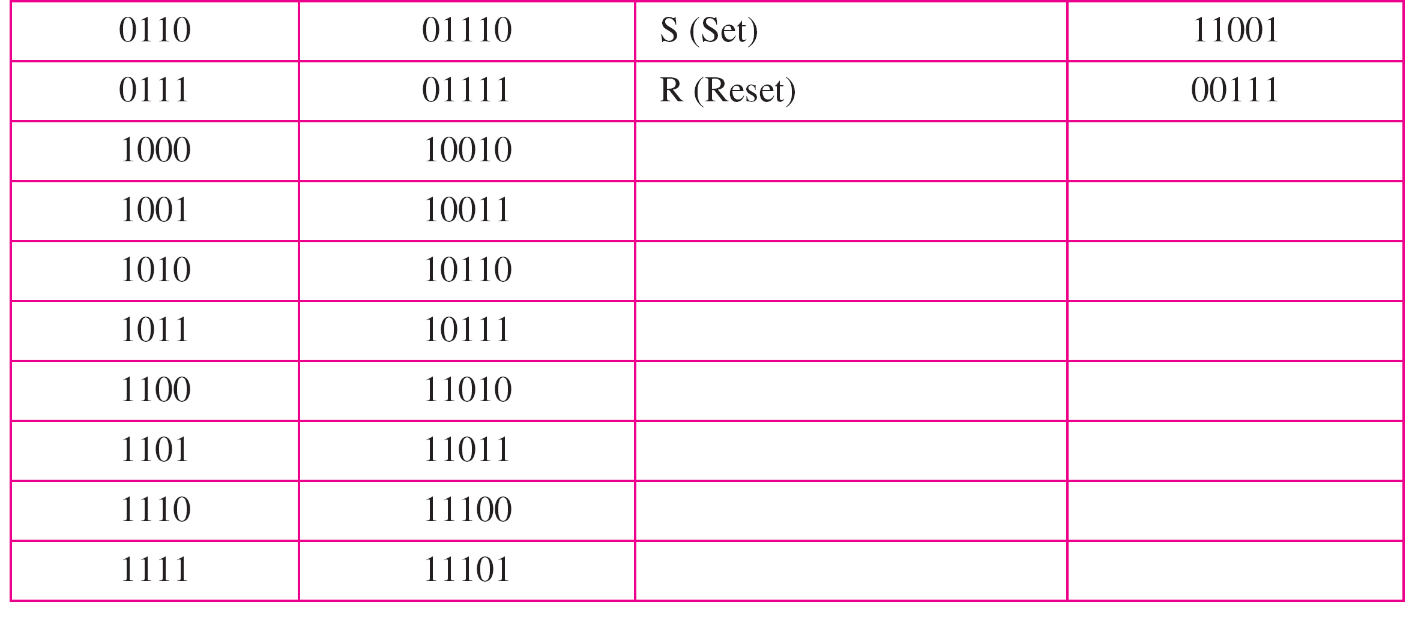
4B/5B mapping codes

Slide 62
4B/5B
Was designed to be used with NRZ-I
NRZ-I was having a synchronization problem for long sequence of 0’s.
Aim is to change the bit stream prior to NRZ-I so that it eliminates long sequence of 0’s.
In 4B/5B Scheme,
The 5-bit code has no more then one leading 0 and no more then two trailing 0’s.
This implies that more then three consecutive 0’s do not occur.

Slide 63
ANALOG-TO-DIGITAL CONVERSION
Two techniques of analog signal to digital data:
Pulse Code Modulation (PCM)
Delta Modulation (DM)

Slide 64
Pulse Code Modulation (PCM)
Technique to change an Analog signal to digital data (digitization) is called pulse code modulation (PCM).
A PCM encoder has three processes.
1. Sampling: The analog signal is sampled.
2. Quantization: The sampled signal is quantized.
3. Encoding: The quantized values are encoded as streams of bits.

Slide 65
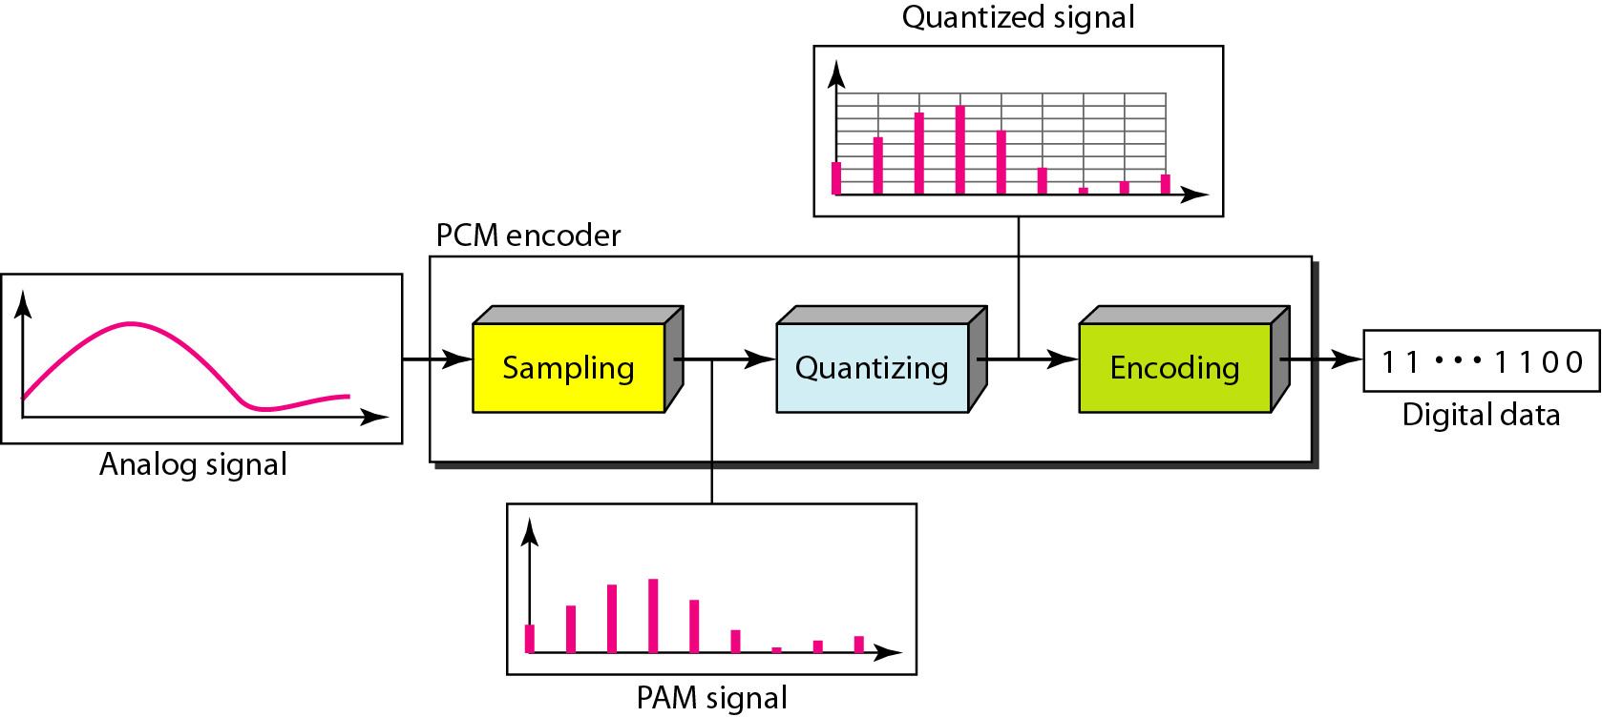
Pulse Code Modulation (PCM)

Slide 66
Sampling
The analog signal is sampled every Ts
where Ts is the sample interval or period.
The inverse of the sampling interval is called the sampling rate or sampling frequency and denoted by fs
where fs = 1/Ts.

Slide 67
Sampling Methods
Ideal : In ideal sampling, pulses at each sampling instant with amplitude equal to signal at that point of time are sampled. This is an ideal sampling method and cannot be easily implemented.
Natural: A pulse of short width with varying amplitude. In natural sampling, a high-speed switch is turned on for only the small period of time when the sampling occurs. The result is a sequence of samples that retains the shape of the analog signal.
Flat-top: The most common sampling method, also called as sample and hold is similar to natural but with constant amplitude value. It creates flat-top samples by using a circuit.

Slide 68
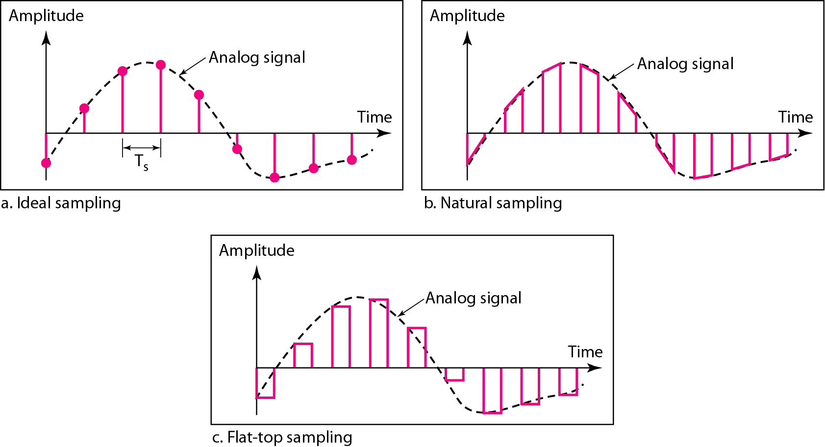
Sampling Methods

Slide 69
How to decide the sampling rate (Ts)
According to Nyquist, to reproduce the original analog signal(at receiver side), the sampling rate must be at least twice the highest frequency of the original signal.
Telephone companies digitize voice by assuming a maximum frequency of 4000 Hz.
The sampling rate therefore is 8000 samples per second.

Slide 70
Quantization
Sampling results in a series of pulses(PAM Signals) of varying amplitude values ranging between two limits: a min and a max.
The amplitude values are infinite between the two limits.
We need to map the infinite amplitude values onto a finite set of known values.
This is achieved by dividing the distance between min and max into L zones, each of height Δ.
Δ = (V_{Max} - V_{Min})/L

Slide 71
Steps of Quantization
The following are the steps of Quantization:
1. We assume that the original analog signal has instantaneous amplitude between Vmin amd Vmax.
2. we devide the range into L zones , each of height of Delta.
Delta= (Vmax-Vmin)/L
3.We Assign quantized value of 0 to L-1 to the midpoint of each zone.
4.We approximate the value of the sample amplitude to the quantized values.

Slide 72
Quantization Levels
The midpoint of each zone is assigned a value from 0 to L-1 (resulting in L values)
Each sample falling in a zone is then approximated to the value of the midpoint.

Slide 73
Quantization Zones
Assume we have a voltage signal with amplitutes V_{min}=-20V and V_{max}=+20V.
We want to use L=8 quantization levels.
Zone width Δ = (20 - -20)/8 = 5
The 8 zones are: -20 to -15, -15 to -10, -10 to -5, -5 to 0, 0 to +5, +5 to +10, +10 to +15, +15 to +20
The midpoints are: -17.5, -12.5, -7.5, -2.5, 2.5, 7.5, 12.5, 17.5

Slide 74
Assigning Codes to Zones
Each zone is then assigned a binary code.
The number of bits required to encode the zones, or the number of bits per sample as it is commonly referred to, is obtained as follows:
n_{b} = log₂ L
Given our example, n_{b} = 3
The 8 zone (or level) codes are therefore: 000, 001, 010, 011, 100, 101, 110, and 111
Assigning codes to zones:
000 will refer to zone -20 to -15
001 to zone -15 to -10, etc.

Slide 75

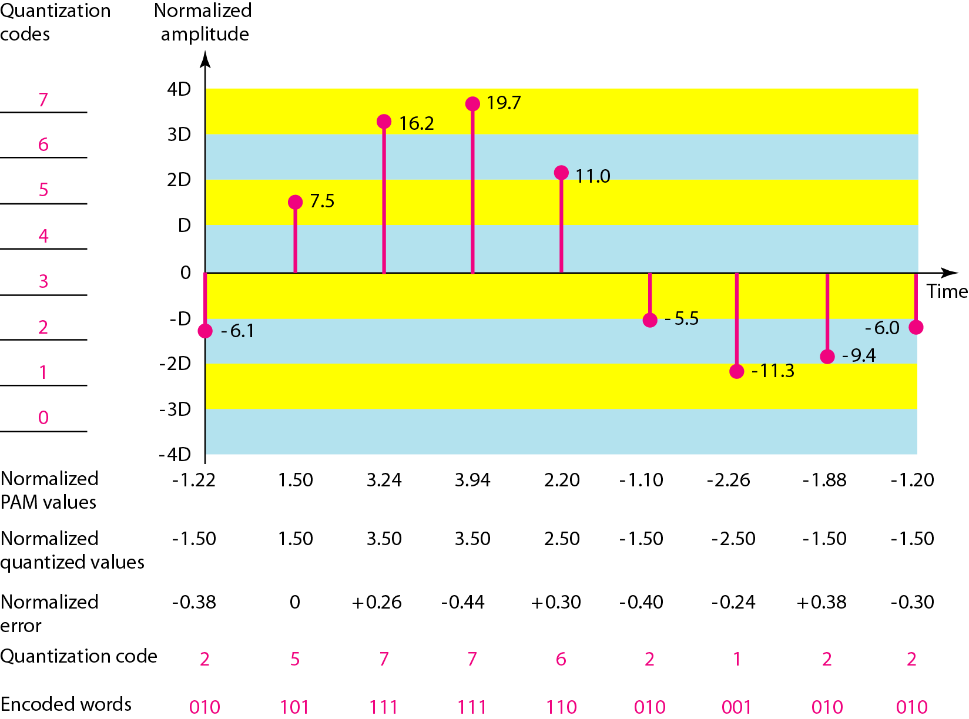
Quantization and encoding of a sampled signal

Slide 76
Quantization Error
Quantization is an approximation process.
When a signal is quantized, we introduce an error - the coded signal is an approximation of the actual amplitude value.
The difference between actual and coded value (midpoint) is referred to as the quantization error.
The more zones, the smaller Δ which results in smaller errors.

Slide 77
Bit rate requirements of PCM
The bit rate pf a PCM signal can be calculated as:
Bit rate = Sampling rate X Number of bits per Sample
= f_{s} X n_{b}
We want to digitize the human voice. What is the bit rate, assuming 8 bits per sample?
Solution:
The human voice normally contains frequencies from 0 to 4000 Hz. So the sampling rate and bit rate are calculated as follows:

Slide 78
Delta Modulation
This scheme sends only the difference between pulses, if the pulse at time t_{n+1} is higher in amplitude value than the pulse at time t_{n}, then a single bit, say a “1”, is used to indicate the positive value.
If the pulse is lower in value, resulting in a negative value, a “0” is used.
This scheme works well for small changes in signal values between samples.
If changes in amplitude are large, this will result in large errors.

Slide 79
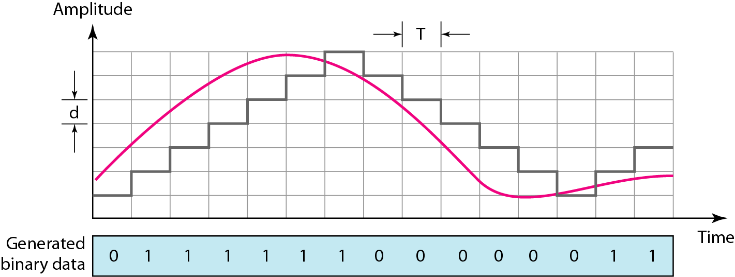
The process of delta modulation

Slide 80
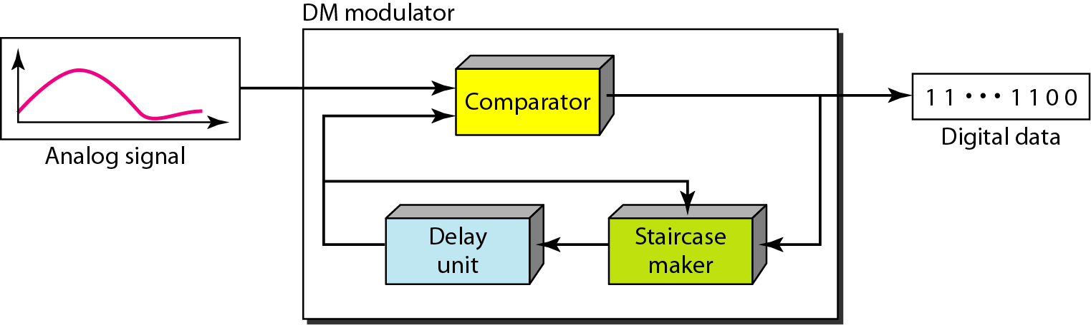
Delta modulation components
The modulator is used at the sender site to create a stream of bits from an analog signal.
The process records the small positive or negative changes, called delta
If the delta is positive, the process records a 1;
if it is negative, the process records a 0.
However, the process needs a base against which the analog signal is compared.

Slide 81
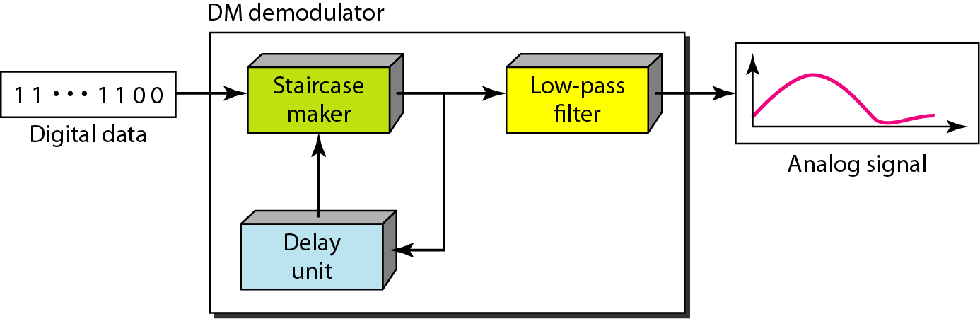
Delta modulation components
The demodulator takes the digital data and, using the staircase maker and the delay unit, creates the analog signal.
The created analog signal, however, needs to pass through a low-pass filter for smoothing.

Slide 82
TRANSMISSION MODES
The transmission of binary data across a link can be accomplished in either parallel or serial mode.
In parallel mode, multiple bits are sent with each clock tick.
In serial mode, 1 bit is sent with each clock tick.

Slide 83
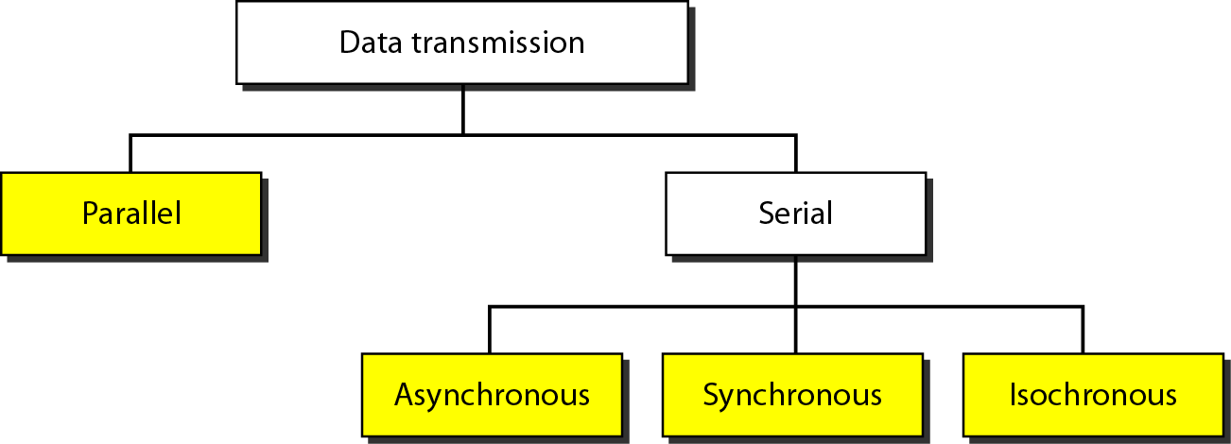
Data Transmission and Modes

Slide 84
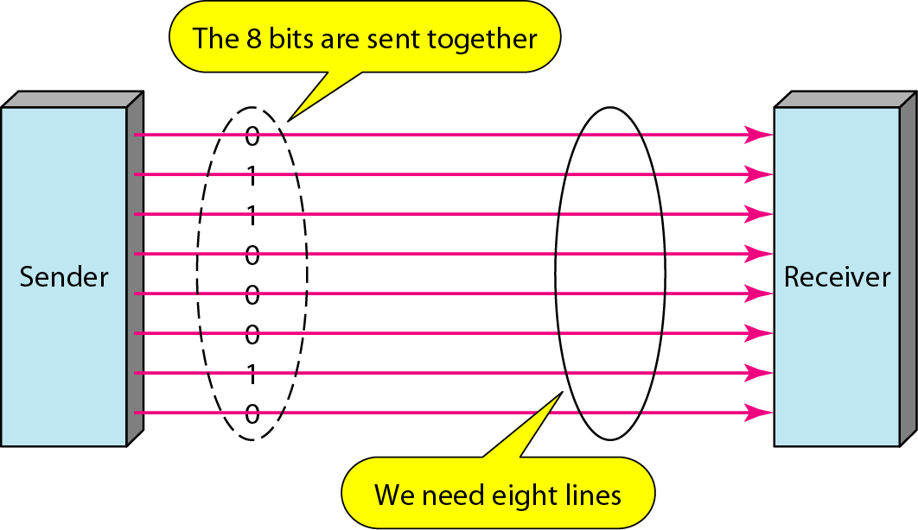
Parallel Transmission

Slide 85
Parallel Transmission
It involves simultaneous transmission of N bits over N different channels.
The advantage of parallel transmission is speed. parallel transmission can increase the transfer speed by a factor of N over serial transmission.
But there is a significant disadvantage: cost.
Parallel transmission requires n communication lines (wires in the example) to transmit the data stream.
Because this is expensive, parallel transmission is usually limited to short distances.

Slide 86
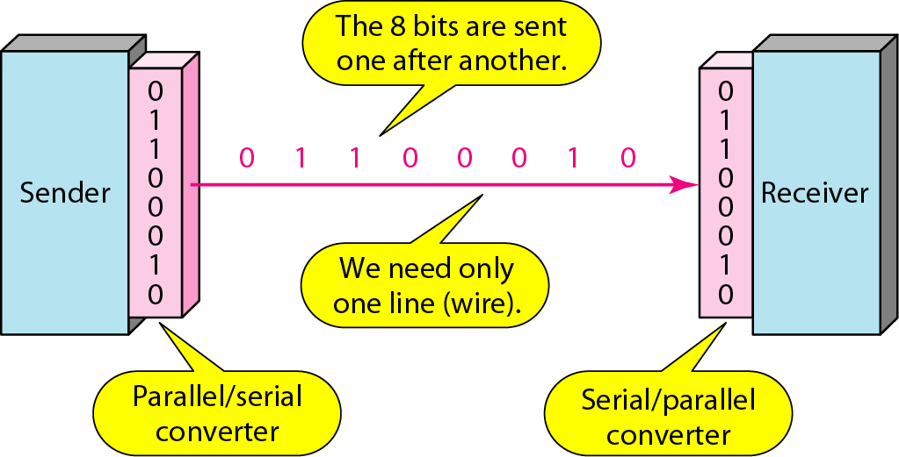
Serial Transmission

Slide 87
Serial Transmission
Data is transmitted serially, i.e bit by bit (one bit at a time).
Single channel is required.
The advantage of serial over parallel transmission is that with only one communication channel, serial transmission reduces the cost of transmission over parallel by roughly a factor of N.
Since communication within device is parallel, so a conversion device is required ( parallel-to-serial) and (serial to parallel)

Slide 88
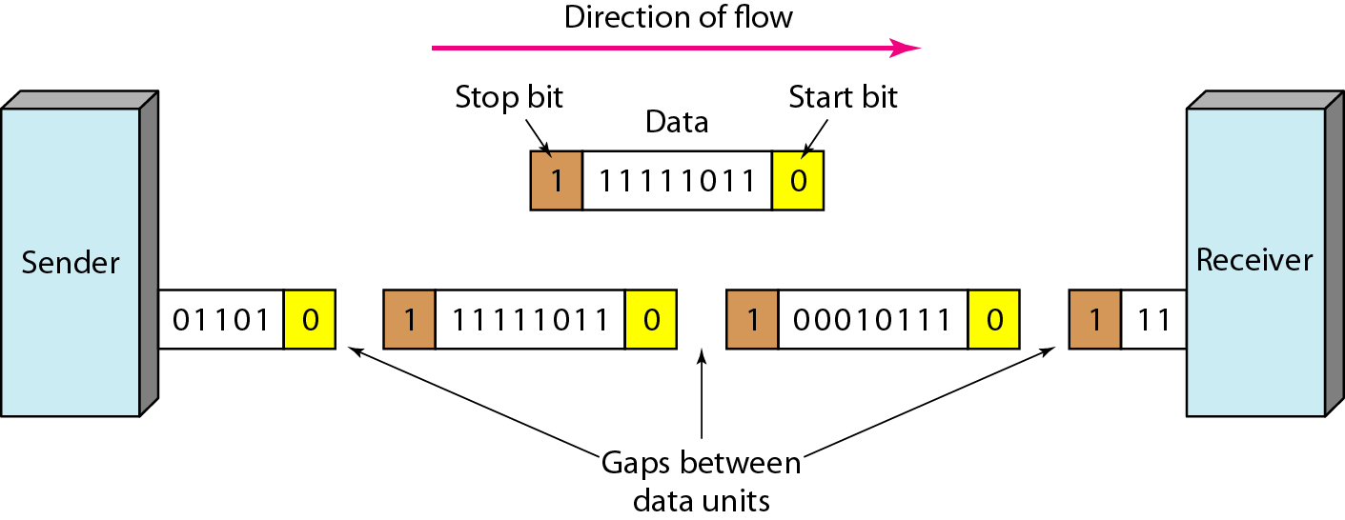
Asynchronous Transmission

Slide 89
Asynchronous Transmission
Asynchronous transmission is so named because the timing of a signal is unimportant.
Instead, information is received and translated by agreed upon patterns.
As long as those patterns are followed, the receiving device can retrieve the information without regard to the rhythm in which it is sent.
Patterns are based on grouping the bit stream into bytes.
Each group, usually 8 bits, is sent along the link as a unit.
The sending system handles each group independently, relaying it to the link whenever ready, without regard to a timer.

Slide 90
Asynchronous Transmission
In asynchronous transmission, we send 1 start bit (0) at the beginning and 1 stop bits (1) at the end of each byte.
There may be a gap between each byte which indicates that there is no data being transmitted by the sender.
Advantage:
It is cheap
Can be used for low speed communication (For example, the connection of a keyboard to a computer ) A user types only one character at a time, types extremely slowly in data processing terms, and leaves unpredictable gaps of time between each character.
Disadvantage:
The addition of stop and start bits and the insertion of gaps into the bit stream make asynchronous transmission slower.

Slide 91
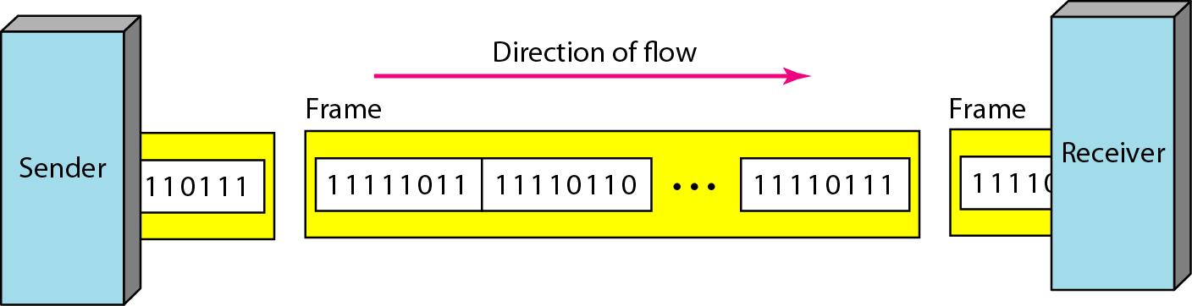
Synchronous Transmission

Slide 92
Synchronous Transmission
In synchronous transmission, we send bits one after another without start or stop bits or gaps.
It is the responsibility of the receiver to group the bits.
Timing becomes very important, therefore, because the accuracy of the received information is completely dependent on the ability of the receiving device to keep an accurate count of the bits as they come in.
The advantage of synchronous transmission is speed.
With no extra bits or gaps, synchronous transmission is faster than asynchronous transmission.
For this reason, it is more useful for high-speed applications such as the transmission of data from one computer to another.

Slide 93
ISOCHRONOUS TRANSMISSION
When uneven delays between frames are not acceptable , the synchronous transmission fails.
Example Frame rate for TV broadcast. Each frame should be viewed at the same rate.
Ther should not be any delays between frames.
For this type of application , synchronization between characters is not enough : the entire stream must be synchronized.
To achieve we use ISOCHRONOUS TRANSMISSION

Slide 94
REFERENCE
Data Communication and Networking, Behrouz A Forouzan (4th Edition)

